Slide 1
Final Analysis Project
Elizabeth Arredondo

Slide 2
Insight 1
Question – When do most purchases occur?

Slide 3
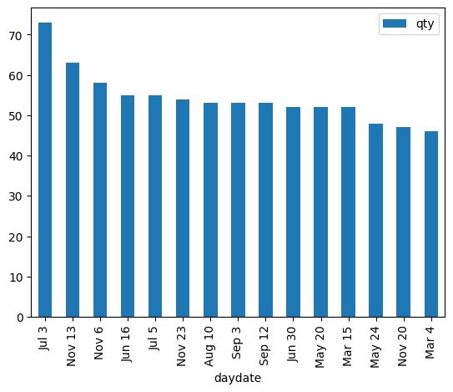
Findings
Higher number of purchases (red) tend to occur
closer to major holidays (yellow)
during the summer months when school is not in session (May – August)
Lowest number of purchases (blue) tend to occur
During Q1 (Jan – Mar) and Q4 (Oct – Dec)
Higher number of purchases contain –
Soft drinks
Cheese
Bag snacks
Baked bread/buns/rolls
Candy – packaged
Higher number of purchases tend to not contain –
Miscellaneous seafood
Tomatoes
Stationery and school supplies
Water
yogurt

Slide 4
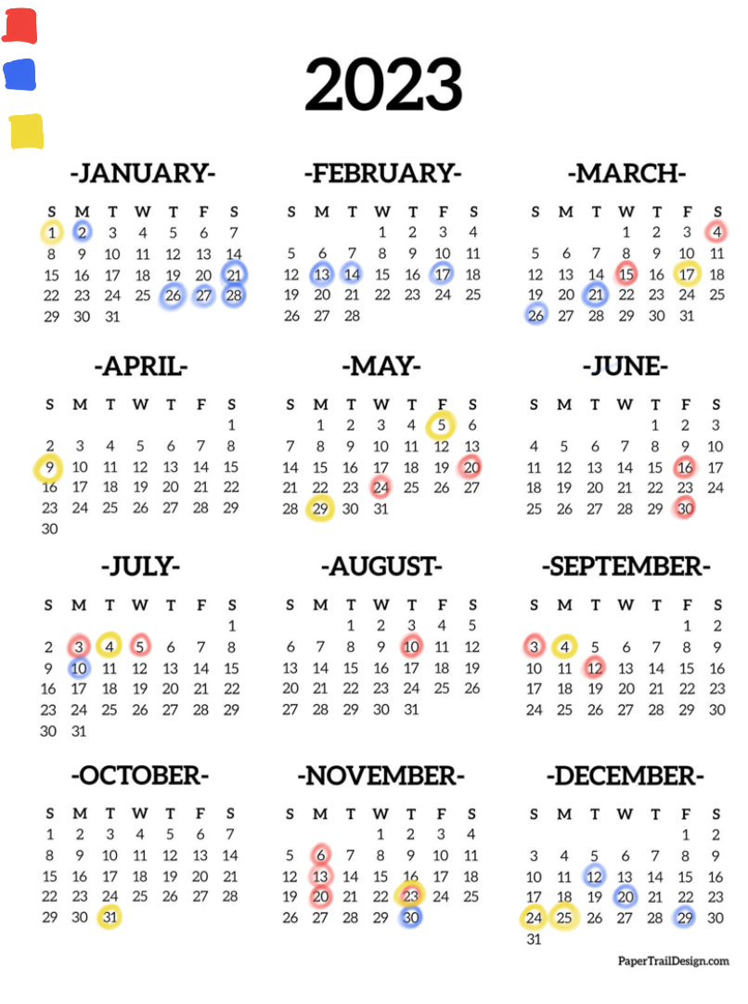
Highest number of purchases
Lowest number of purchases
Major American Holidays

Slide 5
Insight for Businesses
Grocery stores should increase stock of
Soft drinks
Cheese
Bag snacks
Baked bread, buns, rolls
Packaged candy
Closer to major holidays and during the summer months
Grocery stores should decrease stock of
Miscellaneous seafood
Tomatoes
Stationery and school supplies
Water
yogurt
Closer to major holidays and during summer months

Slide 6
Insight 2
Question - Are there advertisement events that coincide with high item purchasing dates? Where do these items’ display locations tend to be located? And are items purchased most on low item purchasing dates from similar display locations?

Slide 7
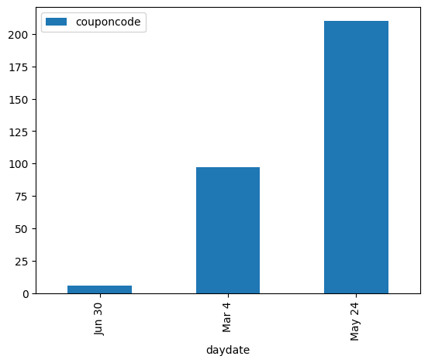
Findings
Dates that coincide with total number of coupon campaigns –
June 30 – 6
March 4 – 97
May 24 – 210
Top products bought –
Fluid white milk
Frozen SS premium entrees, dinners
IWS single cheese
Shredded cheese
Frozen French fries

Slide 8
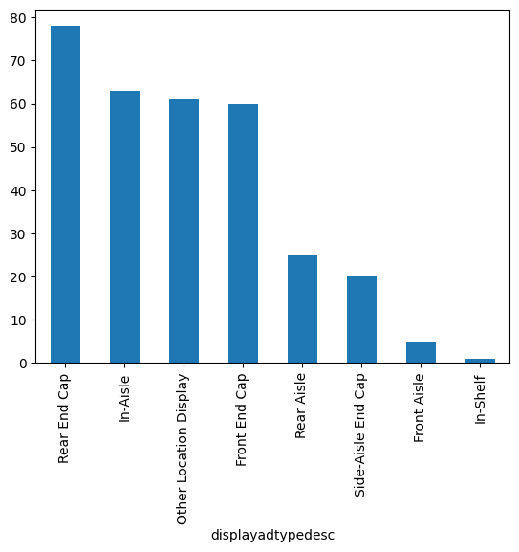
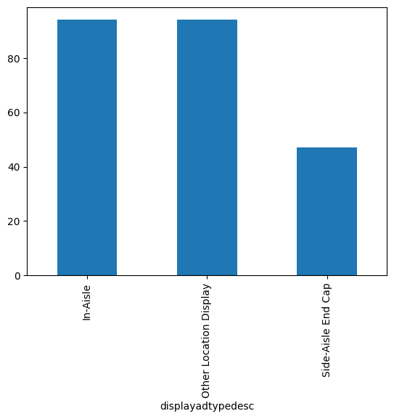
Findings – Item Display Location Comparison
High Item Purchasing Dates
Low Item Purchasing Dates
Top product locations –
Rear end cap - 78
In-Aisle - 63
Other Location Display - 61
Front End Cap - 60
Top product locations –
In-aisle - 94
Other location display - 94
Side-aisle end cap - 47
Notes:
Disclaimer on information displayed –
number of items purchased shows items part of list purchased most in slowest days OR purchase that occurred during slowest days

Slide 9
Insights for Businesses
Grocery stores should prioritize keeping consistent, year-round stock of items located in
In aisles
Other location displays
Grocery stores should also emphasize keeping stock of the following items when coupon events occur during high purchasing times -
Milk
Frozen dinners
Cheese

Slide 10
Insight 3
How often does each age group shop at this store (aka purchase frequency)? Is this consistent with other sources?
Notes:
Something with households!!

Slide 11
Findings – Acme Dataset vs. Outside Dataset
Acme Dataset –
65+ year old customers have highest purchase frequency over one year
25-34 year old customers have lowest purchase frequency over one year
Outside Dataset –
55-64 year old customers have highest purchase frequency over one year
> 25 year old customers have lowest purchase frequency over one year
Conclusion – as customers increase in age, so does their purchase frequency
Younger demographics tend to have children, which can hinder purchase frequency
Older demographics don’t have to worry about children, so they have more free time to shop
Notes:
Younger demographics tend to have younger children or work jobs, which can hinder purchase frequency
Older demographics don’t have to worry about young children and are typically retired, so they have more free time to shop

Slide 12
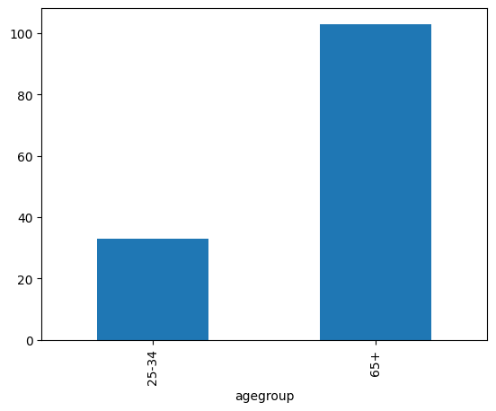
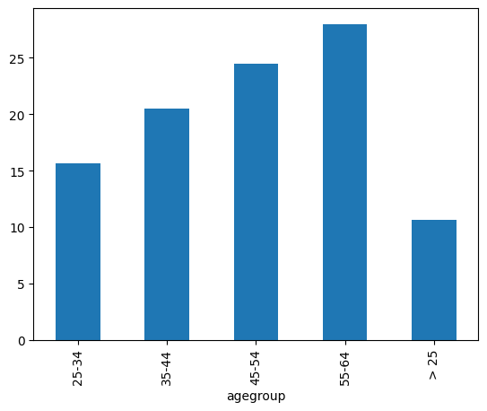
Findings – Visual Comparison
Notes:
Chart shows – age group vs. purchase frequency (number of purchases per year)
Note – median purchase frequency is shown as y-value (for right)

Slide 13
Insights for Businesses
Grocery stores should cater more towards older demographics since they frequent their stores more often than other age demographics
Could include
Accommodations for mobility-challenged
Easy-to-read signage
Plenty of seating areas, such as benches, around store if they are large box stores

Slide 14
Sources
Outside Dataset - https://www.kaggle.com/datasets/hanaksoy/customer-purchasing-behaviors
Pandas Documentation Reference - https://pandas.pydata.org/docs/index.html

